Slide 1
Object Detection
COSCI 223 – Machine Learning 3 🧠
Sebastian C. Ibañez
sibanez@aim.edu
Asian Institute of Management

Slide 2
Outline
Object Detection
Object Detection Models

Slide 3
Object Detection

Slide 4
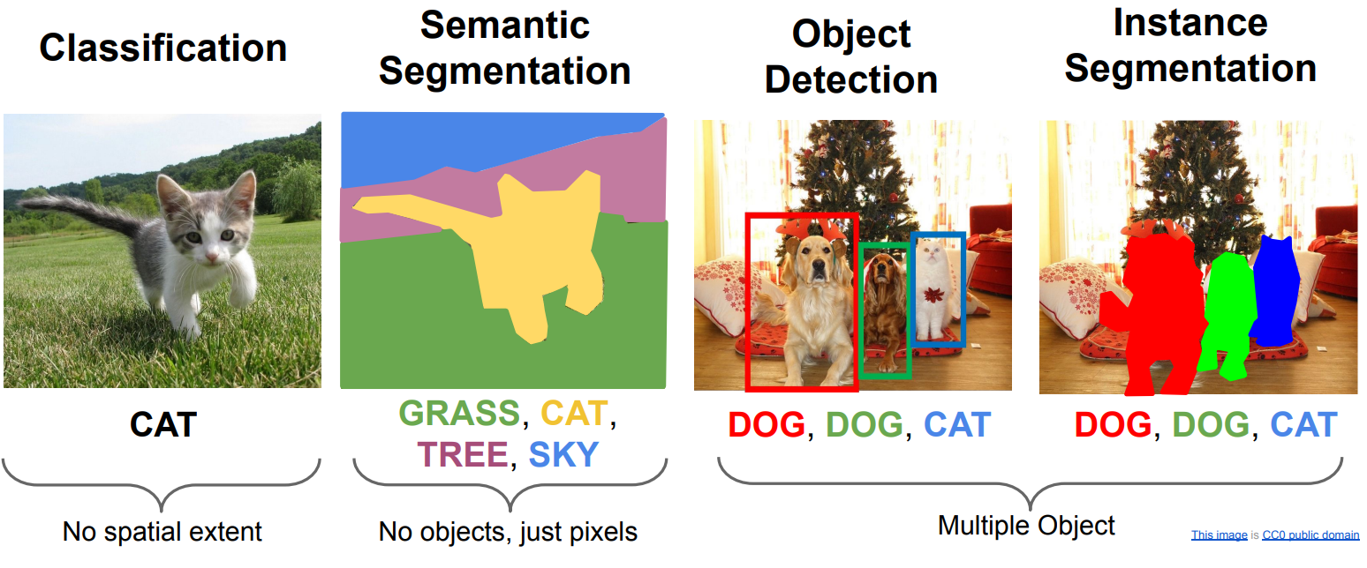
Computer Vision Tasks

Slide 5
Object Detection
Object Detection is essentially a classification + localization problem, where localization refers to finding the appropriate bounding box via regression.

Slide 6
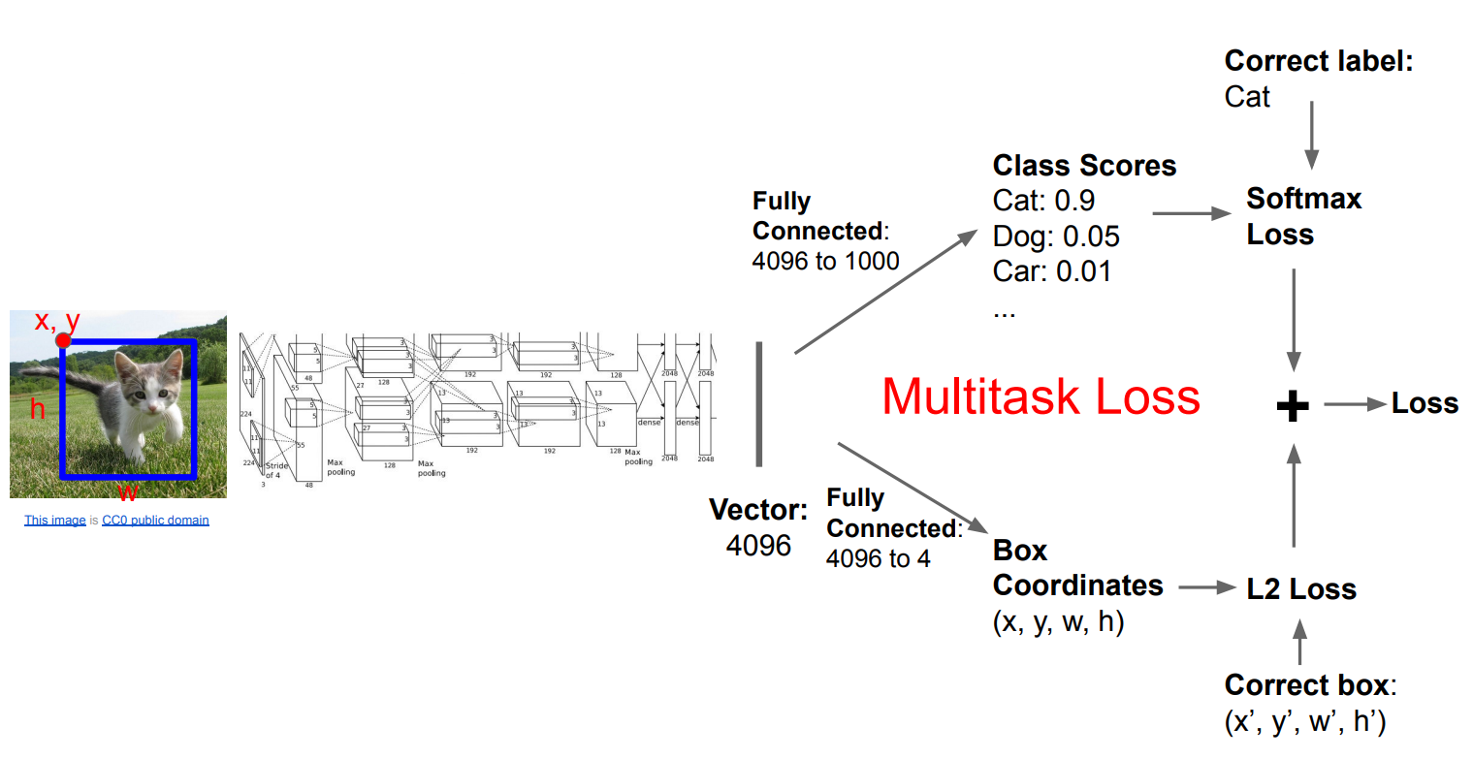
Single Object Detection

Slide 7
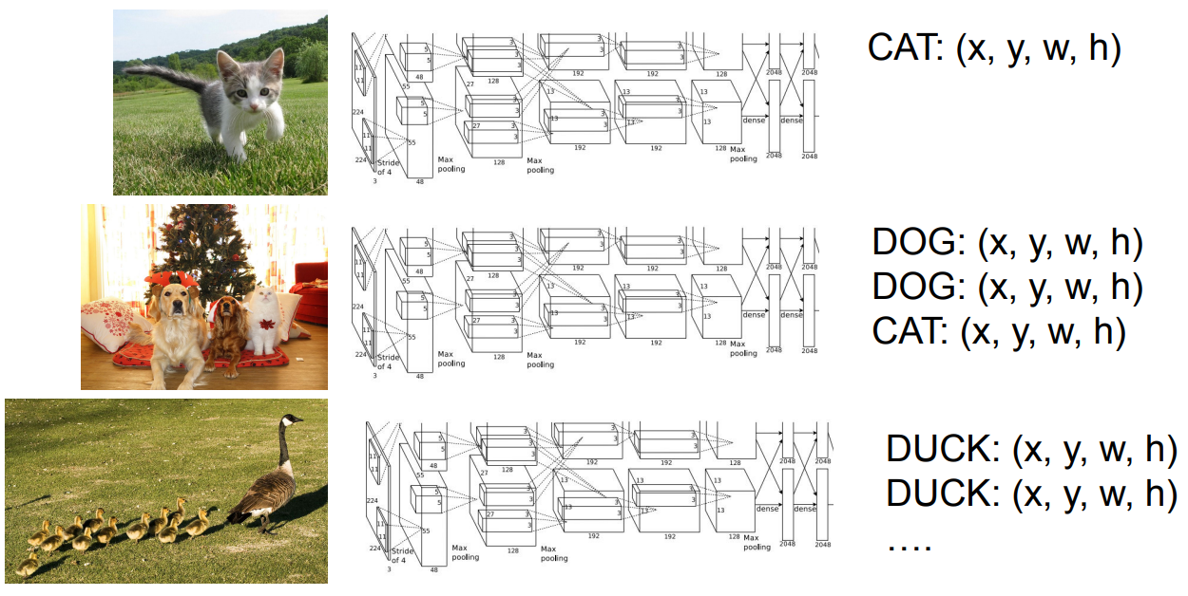
Multi-Object Detection

Slide 8
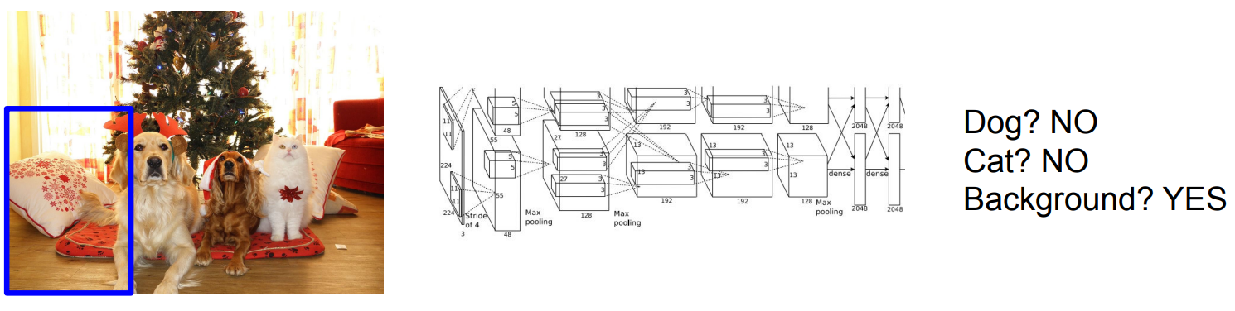
Multi-Object Detection

Slide 9
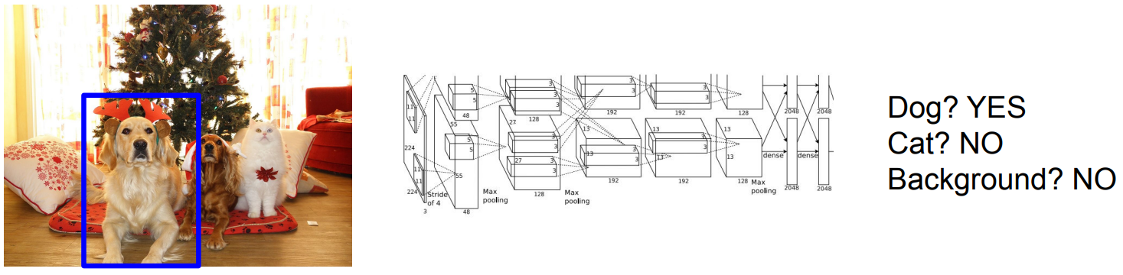
Multi-Object Detection

Slide 10
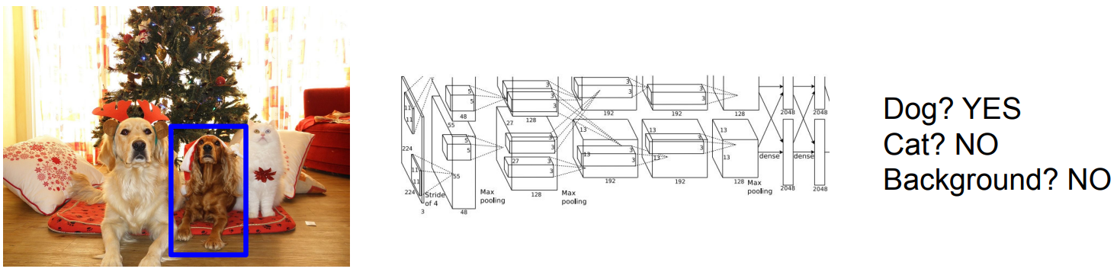
Multi-Object Detection

Slide 11
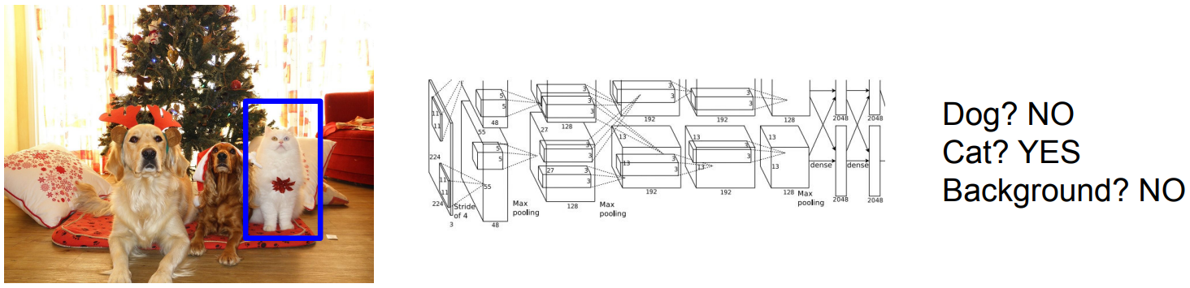
Multi-Object Detection
This style of detection is called one-stage detection.

Slide 12
Object Detection Models

Slide 13
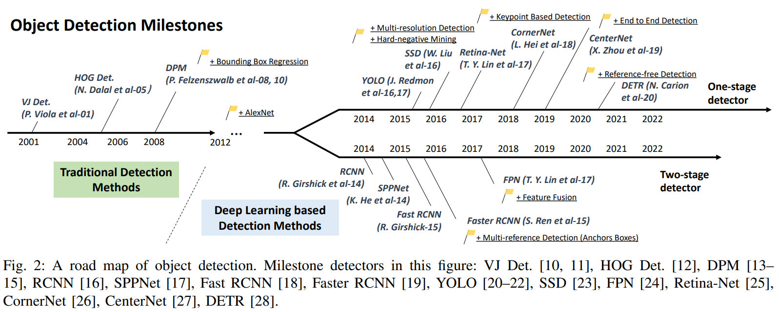
Object Detection Milestones

Slide 14
Object Detection Benchmarks
MS-COCO: 164k images, 897k annotated objects, 80 classes
Pascal VOC: 11k images, 27k annotated objects, 20 classes

Slide 15
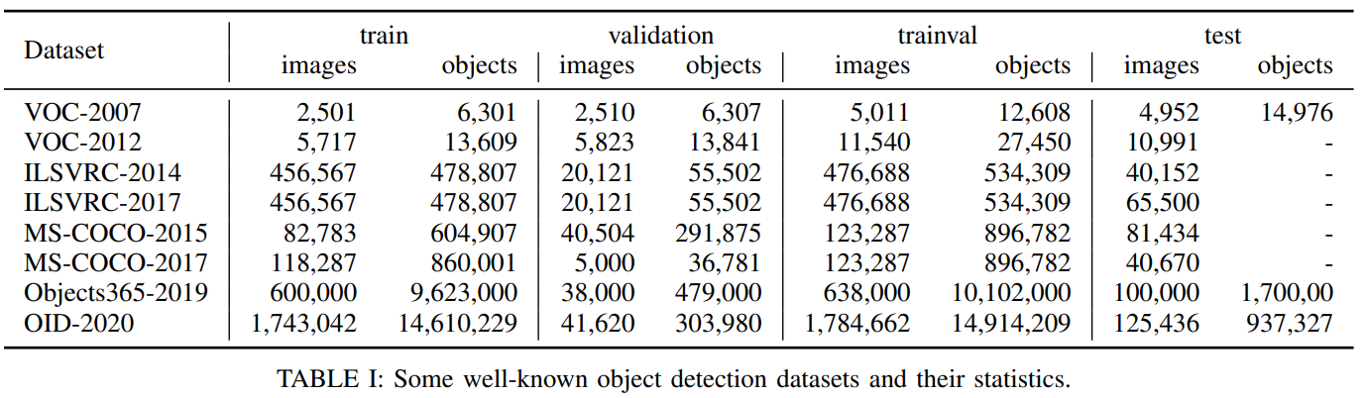
Object Detection Benchmarks

Slide 16
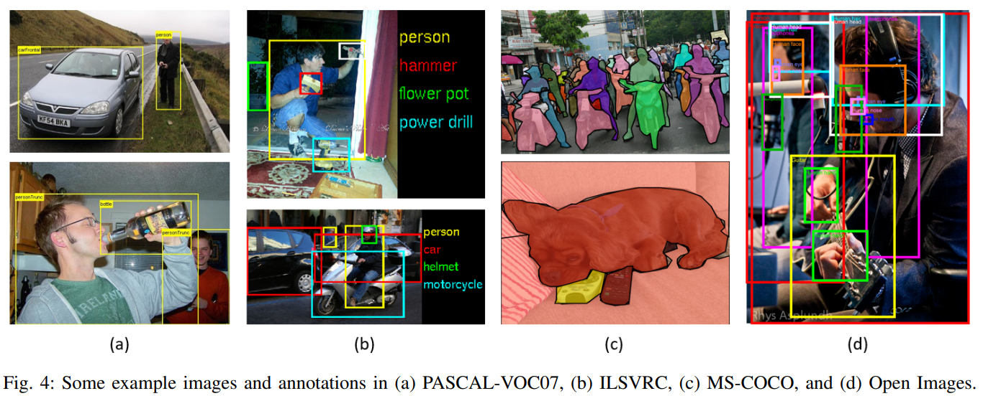
Object Detection Benchmarks

Slide 17
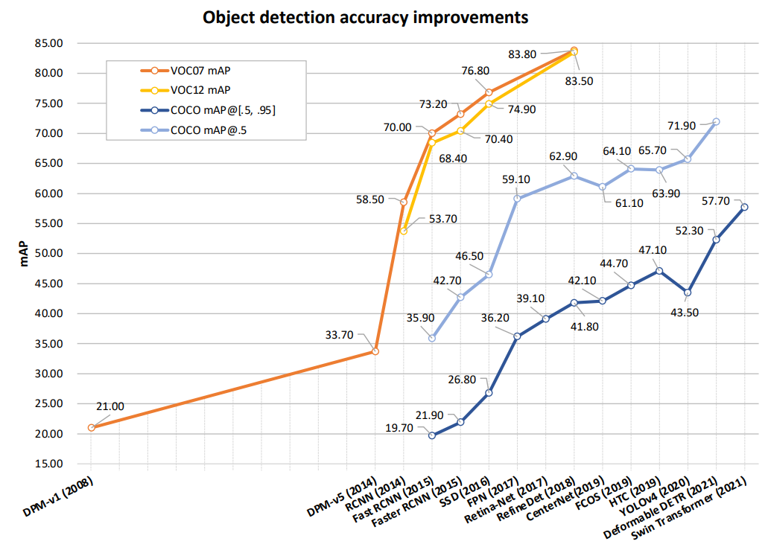
Accuracy Improvements

Slide 18
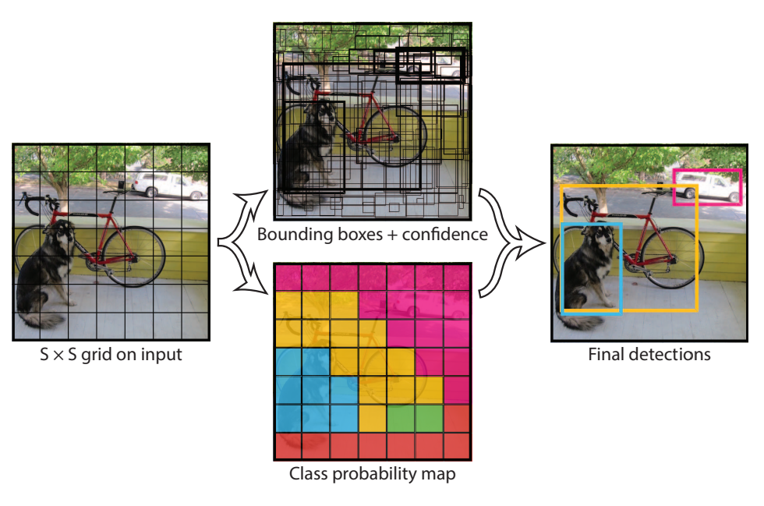
YOLO (2015)
One-stage detector
Big Idea: Speed!
Localization is not as accurate compared to other models, but later versions address this

Slide 19
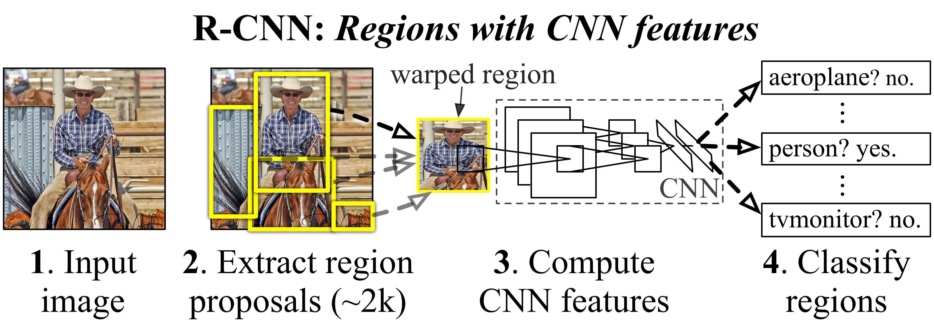
R-CNN (2014)
Two-stage detector
Big Idea: Extract set of region proposals via selective search, then classify

Slide 20
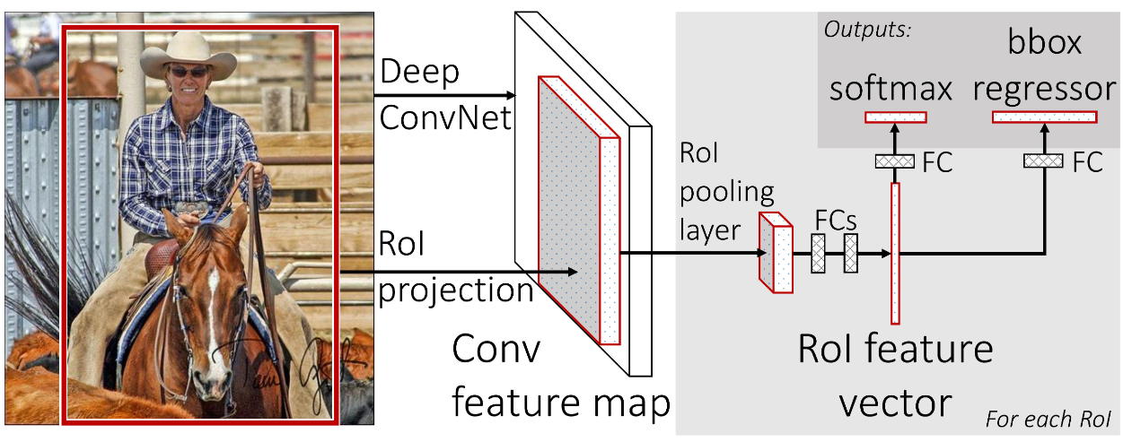
Fast R-CNN (2015)
Improvement on R-CNN
Big Idea: Aggregate region proposals and extract features in a single forward pass, then classify

Slide 21
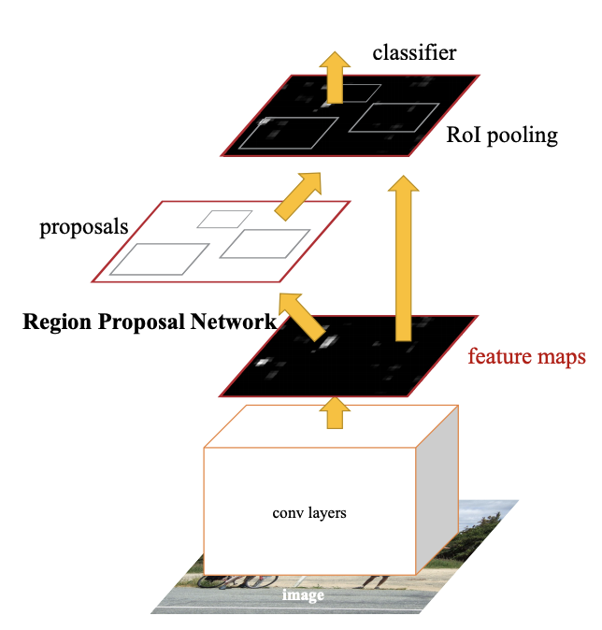
Faster R-CNN (2016)
Improvement on Fast R-CNN
Big Idea: Create a region proposal network (RPN) that shares features with the detection network
Basically, RPN + Fast R-CNN = Faster R-CNN

